Slide 1
21- Theory X, Theory Y, and Motivation
Servant Leadership Core Slides
Dr. Kent M. Keith
2022

Slide 2
Theory X, Theory Y,
and Servant Leadership

Slide 3
Assumptions about people
How you lead is affected by your assumptions about people in the workplace
Some of us think that most people are mean, irresponsible, have no ambition, and will only work if threatened
Others of us think that most people are good, willing to be responsible, want to grow, and will pitch in to help when they are needed

Slide 4
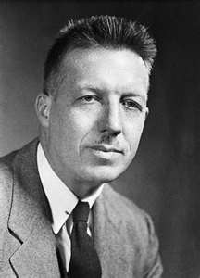
Douglas McGregor (1906-1964)
McGregor was a Professor of Management at MIT
He published his book, The Human Side of Enterprise, in 1960
He coined “Theory X” and “Theory Y” regarding assumptions about people in the workplace

Slide 5
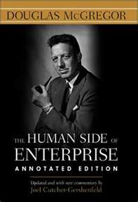
Douglas McGregor: Theory X Assumptions
Most people dislike work, and avoid it if they can
Because they don’t like work, most people must be coerced, controlled, or threatened with punishment to get them to work toward the achievement of organizational objectives
Most people want to be directed and want to avoid responsibility. They have little ambition. They just want to be secure.

Slide 6
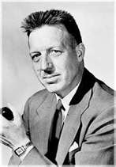
Douglas McGregor: Theory Y Assumptions
Work is as natural as play or rest
The threat of punishment is not the only way to get people to work
People will exercise self-direction and self-control in working toward organizational objectives when they are committed to them

Slide 7
Douglas McGregor: Theory Y Assumptions
Commitment to objectives is a function of the rewards associated with their achievement
Most people learn not only to accept but to seek responsibility

Slide 8
Theory Y
A lot of people have the capacity to exercise a relatively high degree of imagination, ingenuity, and creativity in solving organizational problems
But under the conditions of modern industrial life, the intellectual potential of most people is only partially utilized

Slide 9
Employees’ fault
McGregor said that Theory X managers don’t let employees contribute their best work, then blame employees for not contributing their best
They say employees are lazy, indifferent, unwilling to take responsibility, uncreative, and uncooperative
Poor performance is the employees’ fault

Slide 10
Management’s fault
Theory Y says that if employees are not contributing their best work, it is management’s fault, not the employees’ fault
Employees have a lot of potential
Managers need to help them realize that potential
That’s management’s job

Slide 11
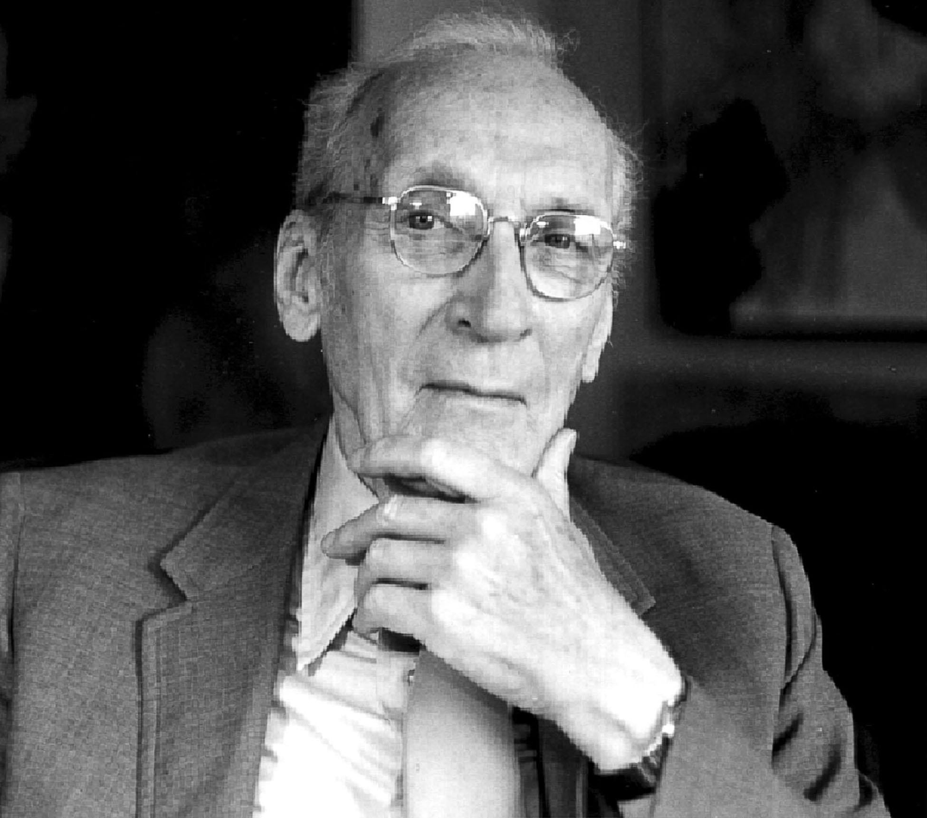
Robert Greenleaf went further than Theory Y
McGregor invited Greenleaf to teach at MIT
Greenleaf asked: Why not grow people and then invite them to make their maximum contribution to the organization?
He said that an organization’s most fundamental business is growing people

Slide 12
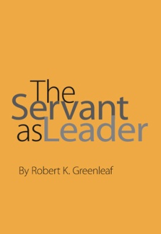
The best test of a servant-leader
Greenleaf said that the best test of a servant leader is this: “Do those served grow as persons? Do they, while being served, become healthier, wiser, freer, more autonomous, more likely themselves to become servants?”

Slide 13
What servant leaders do
Servant leaders help people to develop and then utilize their full potential (“Theory Y Plus”)
Most people have talents or abilities that can be grown and applied to serving others
Helping people to develop and use their talent is a noble task– and a high priority for servant leaders

Slide 14
Comments or questions…

Slide 15
From Extrinsic Motivation to Intrinsic Motivation

Slide 16
Extrinsic motivation
Extrinsic motivation is what you have to do, not what you want to do
The task is not seen as fun, interesting, fulfilling, or meaningful
Managers offer incentives or threats of punishment to get the task done
The idea is that if you do this, you will get that

Slide 17
Intrinsic motivation is different…
Intrinsic motivation is about what you want to do, not what you have to do
People are intrinsically motivated when they do something because it is fun, interesting, fulfilling, meaningful
When you are intrinsically motivated, the work itself is your reward

Slide 18
Reflection
Are you intrinsically or extrinsically motivated? Or both?
What extrinsic rewards are most attractive to you?
What intrinsic rewards are most attractive to you?

Slide 19
Extrinsic motivation
Extrinsic motivation is deeply ingrained in our cultures and our organizations
It affects how we raise children, teach students, and “manage” employees
Many of today’s practices are based on the research done by B.F. Skinner on rats and pigeons (not humans) fifty years ago

Slide 20
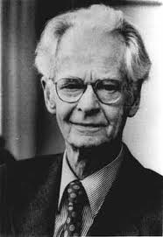
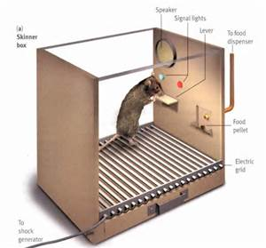
B.F. Skinner (1904-1990)
Skinner invented the operant conditioning chamber for rats
He believed that human free will was actually an illusion
He said that if the consequences of an action are bad, there is a high chance the action will not be repeated; if the consequences are good, the actions that led to it will be reinforced

Slide 21
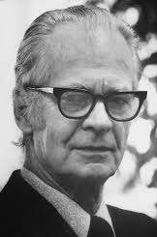
Problems with Skinner
Skinner assumed the brain is a “tabula rasa,” a blank slate; however, we know we are born with inherited characteristics
Skinner denied the existence of a core spirit, soul, or personality
Despite the fact that a majority of Americans identify a religion and have a spiritual practice, Skinner’s ideas have taken over our secular culture

Slide 22
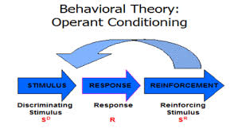
Operant conditioning depends on extrinsic motivators— rewards and punishments
The effectiveness of extrinsic motivators is a controversial issue
Decades of research chronicle the limitations or negative impacts of extrinsic motivation

Slide 23
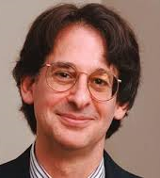
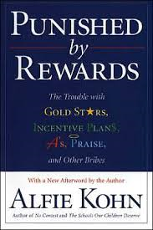
Alfie Kohn (1993) Punished by Rewards
Kohn reviewed hundreds of studies on the impact of extrinsic rewards/punishments
Extrinsic rewards work best in the short term (but people always want more, and more)
Extrinsic rewards devalue the work or activity (the work is not as important as the reward)
Extrinsic rewards undermine performance (people just want the reward, will take shortcuts to get it)

Slide 24
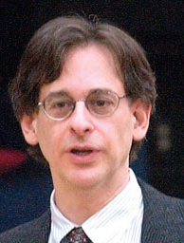
Alfie Kohn Punished by Rewards
Extrinsic rewards can kill intrinsic motivation
Pay-for-performance and incentive systems often fail to increase performance and are sometimes counterproductive
Pay is not the most important motivator (usually #5 or #6 on a list of top ten) contrary to what managers think

Slide 25
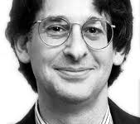
Alfie Kohn Punished by Rewards
Rewards are controlling, coercive behavior that can result in resentment, especially when withheld
Rewards are used instead of learning why performance is poor or could be better (rewards hide the problems)
Rewards discourage risk-taking; people will only do what is needed to get the reward, manipulating numbers, pressuring others, etc

Slide 26
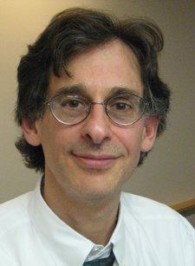
Alfie Kohn Punished by Rewards
When employees set goals, they set them at safe levels, lower than could be achieved
Negative self-fulfilling prophecy: if people are managed through rewards and punishments, they come to see only the rewards and punishments
Kohn concluded: Rewards do not result in people doing a better job

Slide 27
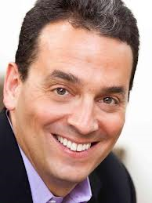
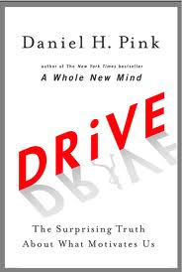
Daniel Pink Drive (2009)
Daniel Pink reviewed the literature and published a book titled Drive: The Surprising Truth About What Motivates Us
He shared some of his findings in a talk on “The Puzzle of Motivation”

Slide 28
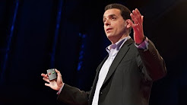
Daniel Pink
Video clip - “The Puzzle of Motivation”
https://www.youtube.com/watch?v=rrkrvAUbU9Y

Slide 29
Daniel Pink Drive (2009)
Pink gave seven reasons carrots and sticks don’t work:
They can extinguish intrinsic motivation (turns an activity into “work”)
They can diminish performance (focus is on the reward, not the work itself)
They can crush creativity (rewards narrow the focus, limit the depth, breadth of thinking)
They can crowd out good behavior (something done for its own sake)

Slide 30
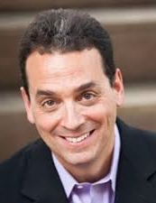
Daniel Pink Drive
More reasons carrots and sticks (often) don’t work
They encourage cheating, shortcuts, and unethical behavior
They can become addictive (people need larger and more frequent rewards)
They can foster short-term thinking (they limit thinking to what’s immediately before us; just far enough to trigger the reward)

Slide 31
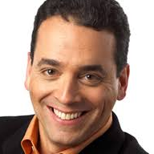
Daniel Pink Drive
Extrinsic rewards can work when:
The tasks are routine, not very interesting, and don’t demand much creative thinking
The extrinsic reward is unexpected and offered only after the task is complete (not “if-then” but “now that”…)
The reward is non-tangible (e.g. feedback, useful information about performance)

Slide 32
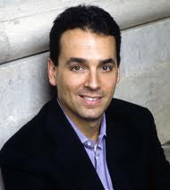
Daniel Pink Drive
Pink identified three elements that define the “Type I” or intrinsically motivated person at work:
Autonomy
Mastery
Purpose

Slide 33
Daniel Pink Drive (2009)
Type “I” behavior (intrinsically motivated):
Is made, not born (doesn’t depend on age, gender)
Outperforms extrinsic Type X behavior in the long run
Doesn’t disdain money or recognition
Is a renewable resource
Promotes greater physical and mental well-being

Slide 34
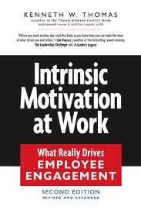
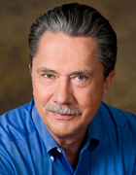
Intrinsic motivation at work
Dr. Kenneth W. Thomas and his colleagues studied intrinsic motivation at work
They concluded that “we are now at the point where the biggest gains will come from systematically improving intrinsic rewards—making the work itself more fulfilling and energizing so that workers don’t want to leave it.”

Slide 35
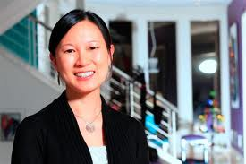
Benefits of intrinsic motivation at work
“Studies show that the intrinsic rewards are consistently related to job satisfaction and to performance. These findings hold across types of organizations and for managers as well as workers.”
--Dr. Kenneth W. Thomas, Intrinsic Motivation at Work: Building Energy and Commitment

Slide 36
Benefits of intrinsic motivation at work
“Studies have also shown that the intrinsic rewards are related to innovativeness, commitment to the organization, and reduced stress.”
--Dr. Kenneth W. Thomas, Intrinsic Motivation at Work: Building Energy and Commitment

Slide 37
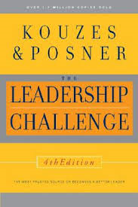
James Kouzes and Barry Posner The Leadership Challenge
“The research is very clear. External motivation is more likely to create conditions of compliance or defiance; self-motivation produces far superior results. There’s even an added bonus. People who are self-motivated will keep working toward a result even if there’s no [extrinsic] reward...”

Slide 38
James Kouzes and Barry Posner The Leadership Challenge
“If people are going to do their best, they must be internally motivated... When it comes to excellence, it’s definitely not ‘What gets rewarded gets done,’ it’s ‘What is rewarding gets done.’”

Slide 39
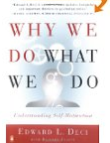
Intrinsic aspirations are good for mental health
Edward L. Deci reported on a study comparing intrinsic and extrinsic aspirations
The extrinsic aspirations were to be rich, famous, and physically attractive
The intrinsic aspirations were to have meaningful relationships, grow as a person, and contribute to the community

Slide 40
Intrinsic aspirations are good for mental health
The extrinsic aspirations were about what you have
The intrinsic aspirations were about who you are
Those with intrinsic aspirations were mentally healthier— had greater vitality, were more content, had greater self-esteem

Slide 41
Intrinsic motivation at work
During sixteen years of research, Dr. Kenneth W. Thomas and his colleagues identified four intrinsic rewards at work:
a sense of meaning
a sense of choice
a sense of competence
a sense of accomplishment

Slide 42
A sense of meaningfulness
“A sense of meaningfulness is the opportunity you feel to pursue a worthy task purpose…that you are on a valuable mission, that your purpose matters in the larger scheme of things.”
--Dr. Kenneth W. Thomas, Intrinsic Motivation at Work: Building Energy and Commitment

Slide 43
A sense of choice
“A sense of choice is the opportunity you feel to select task activities that make sense to you and to perform them in ways that seem appropriate. The feeling of choice is the feeling of being free to choose— of being able to use your own judgment and act out of your own understanding of the task.”
--Dr. Kenneth W. Thomas, Intrinsic Motivation at Work: Building Energy and Commitment

Slide 44
A sense of competence
“A sense of competence is the accomplishment you feel in skillfully performing task activities you have chosen. The feeling of competence involves the sense that you are doing good, high-quality work on a task.”
--Dr. Kenneth W. Thomas, Intrinsic Motivation at Work: Building Energy and Commitment

Slide 45
A sense of accomplishment
“A sense of progress is the accomplishment you feel in achieving the task purpose. The feeling of progress involves the sense that the task is moving forward, that your activities are really accomplishing something.”
--Dr. Kenneth W. Thomas, Intrinsic Motivation at Work: Building Energy and Commitment

Slide 46
Reflection
Which of the four intrinsic motivators identified by Dr. Thomas is most important to you?
Which of the four intrinsic motivators is least important to you?

Slide 47
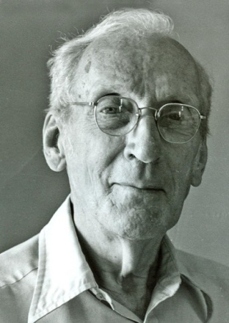
Greenleaf’s intrinsic motivators
Greenleaf focused on:
Helping people grow, which can result in a sense of competence and accomplishment
The meaningfulness of the work itself

Slide 48
Reflection
What do you enjoy doing?
What did you enjoy doing when you were 7? When you were14?
If you had millions of dollars and didn’t have to earn a living, what would you do with your life? Why?

Slide 49
Comments or questions…

Slide 50
Frederick Herzberg (1923-2000)
One of the most-read articles in the history of the Harvard Business Review was an article by Frederick Herzberg published in 1968 titled: “One More Time: How Do You Motivate Employees?”
It was a classic– by 1987, more than 1.2 million copies had been sold, which was 300,000 more than the runner-up

Slide 51
Frederick Herzberg (1923-2000)
Herzberg distinguished between movement and motivation. He said:
“Movement is a function of fear of punishment or failure to get extrinsic rewards. It is the typical procedure used in animal training and its counterpart, behavioral modification techniques for humans.”

Slide 52
Frederick Herzberg (1923-2000)
By contrast, “motivation is a function of growth from getting intrinsic rewards out of interesting and challenging work.”
You can make a person “move” but that does not mean that the person is motivated

Slide 53
Frederick Herzberg (1923-2000)
He described three philosophies of personnel management:
Organizational theory— focused on efficient job structure, which will result in favorable employee attitudes
Industrial engineering— focused on attuning the employee to the most efficient work process

Slide 54
Frederick Herzberg (1923-2000)
The third philosophy of personnel management was:
Behavioral science— focused on group sentiments, attitudes of individual employees, and the organization’s social and psychological climate
The behavioral science approach emphasizes various hygiene and motivator needs

Slide 55
Frederick Herzberg (1923-2000)
The hygiene needs “can be thought of as stemming from humankind’s animal nature—the built-in drive to avoid pain from the environment” as well as basic biological needs, like hunger, which make it necessary to earn money, so money becomes a specific drive
“The stimuli inducing pain-avoidance behavior are found in the job environment.”

Slide 56
Frederick Herzberg (1923-2000)
The motivator needs relate to “that unique human characteristic, the ability to achieve and, through achievement, to experience psychological growth”
“The stimuli for the growth needs are tasks that induce growth; in the industrial setting, they are the job content.”

Slide 57
Hygiene factors (extrinsic)
Hygiene factors are company policy and administration; supervision; relationship with the supervisor; work conditions; salary; relationships with peers; personal life; relationships with subordinates; status; security
These factors are the primary cause of extreme dissatisfaction on the job. Employers need to get these right so that employees will not be dissatisfied.

Slide 58
Intrinsic motivators
Extreme satisfaction comes from intrinsic motivators: Achievement; recognition; the work itself; responsibility; advancement; growth.
The hygiene factors and intrinsic motivators are not the opposite of each other; they represent different needs
More and better hygiene factors will not produce extreme satisfaction— only intrinsic motivators will do that

Slide 59
Intrinsic motivators
Herzberg focused on job enrichment
He said that “it is the content [of the job] that will produce the motivation, not attitudes about being involved or the challenge inherent in setting up a job.”
“Job enrichment will not be a one-time proposition, but a continuous management function… The very nature of motivators… is that they have a much longer term effect on employees’ attitudes.”

Slide 60
Intrinsic motivators
Herzberg concluded:
“If only a small percentage of the time and money that is now devoted to hygiene… were given to job enrichment efforts, the return in human satisfaction and economic gain would be one of the largest dividends that industry and society have ever reaped through their efforts at better personnel management.”

Slide 61
Comments or questions…

Slide 62
Servant-leaders are meaning-makers
Servant-leaders help their colleagues to be motivated by understanding the meaning of the organization’s work
They help their colleagues to understand the meaning of their specific roles at work
They redesign work where possible to make it more meaningful

Slide 63
Disengaged
When people do not find meaning in their work, they are likely to be disengaged, not really committed to their work or their organization
Employee disengagement is a tragic problem all over the world

Slide 64
Gallup surveys employees worldwide, and divides them into three groups
“Engaged” employees work with passion and feel a proud connection to their company. They drive innovation and move the organization forward.
“Not engaged” employees are essentially “checked out.” They’re sleepwalking through their workday, putting time— but not energy or passion— into their work.

Slide 65
“Actively disengaged” employees aren’t just unhappy at work; they’re busy acting out their unhappiness. Every day, these workers undermine what their engaged coworkers accomplish.
According to Gallup, “The majority of the global workforce is not engaged… Converting this group of employees into engaged workers is the most effective strategy that any organization can implement to increase performance and sustainable long-term growth.”

Slide 66
Employee disengagement
Employee disengagement rates are very high all over the world
Generally, surveys by Gallup indicate that fewer than 20% of employees are actively engaged, 60% are moderately engaged, and as many as 20% are actively disengaged (working against the organization)

Slide 67
According to a company named HRSoft, disengaged employees are estimated to cost American companies more than $500 billion annually
One way to improve the economy is to re-engage employees

Slide 68
According to an organization known as “Spark,” one way to re-engage employees is to find out what motivates them
They quote an Inc. magazine article about re-engaging employees that explains: "What the best managers do is learn specifically what motivates each of their people — especially those who are disengaged — and then they meet to sculpt the nature of their employees' jobs just a bit to better meet their motivating drivers."

Slide 69
Comments or questions…

