Slide 1
15- Your Organizational Community
Servant Leadership Core Slides
Dr. Kent M. Keith
2020

Slide 2
What does your organization look like?

Slide 3
Individual exercise
Draw your organization
Mark yourself and three colleagues
What are the advantages and disadvantages of your organizational structure?

Slide 4
Organizational purpose…
We come together in organizations to achieve things that we cannot achieve alone
Organizations exist to serve people in a variety of different ways
Whether it is a business or a non-profit or a school or a government agency, the purpose of every organization is to meet serve others

Slide 5
Need vs purpose
You must get the resources to do the work, and earn enough money to keep going. That’s an organizational need.
But getting resources is not the organization’s purpose. The purpose is to serve others.

Slide 6
Meeting needs…
Organizations get paid or receive resources in different ways— through customer purchases, donations, or taxes— but they all get paid or receive resources so they can meet the needs of others
The best organizational type or structure may depend on the need that is being addressed

Slide 7
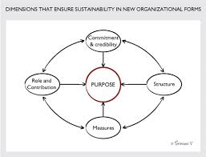
Organizational forms
Sole proprietorship
Partnership
Non-profit organization
For-profit corporation
B Corporation
Government agency

Slide 8
The right form…
Pick the form of organization that fits your circumstances:
If you have funding, you can start your own sole proprietorship or partnership
If others are willing to donate, you can start a nonprofit
If others are willing to invest for positive social impact, you can start a social business (B corporation)

Slide 9
The right form…
Pick the form of organization that fits your circumstances:
If others are willing to invest for long-term gain, you can start a for-profit corporation
If the need is best addressed by government, you can seek new legislation and/or funding to start or expand a government agency that can do the work

Slide 10
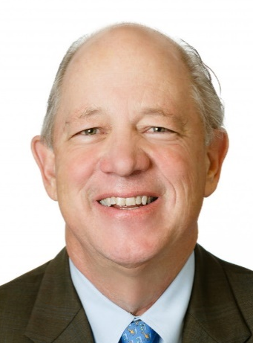
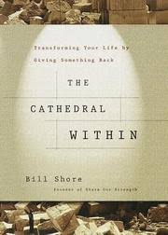
Bill Shore The Cathedral Within
Bill Shore describes how non-profit organizations have created businesses to provide jobs for the poor, the disabled, and former prisoners
A for-profit business can sponsor a nonprofit organization
The best form of organization may be a partnership your organization forms with other organizations

Slide 11
Comments or questions…

Slide 12
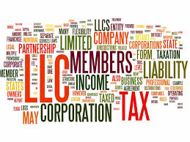
Reflection
Do you have a preference for the form of the organization at which you work? If so, why? If not, why not?

Slide 13
Your Organization
as a Community

Slide 14
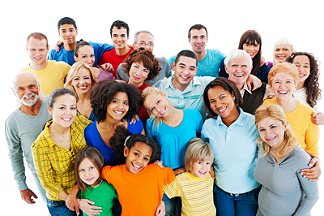
The need to belong
One of our needs as humans is to belong; we are social beings; we benefit from the support of a community
We spend most of our day at work, so it is important to have a community at work
We can have a community at work even though we have different roles and titles and backgrounds
Being in a community is about being human

Slide 15
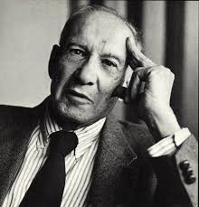
Peter F. Drucker Management expert (1909-2005)
Drucker did a classic study of General Motors Corporation, titled The Concept of the Corporation
He said that the big business corporation is America’s representative social institution, stating that “its social function as a community is as important as its economic function as an efficient producer.”

Slide 16
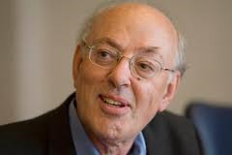
Henry Mintzberg Professor of Management McGill University
Mintzberg said: “Beneath the economic crisis lies another crisis of far greater proportions: the depreciation in companies of community—people’s sense of belonging to and caring for something larger than themselves…”
Community is “the social glue that binds us together for the greater good…”

Slide 17
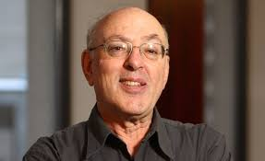
Henry Mintzberg interview
https://www.youtube.com/watch?v=fnAq7638uX4

Slide 18
Comments or questions…

Slide 19
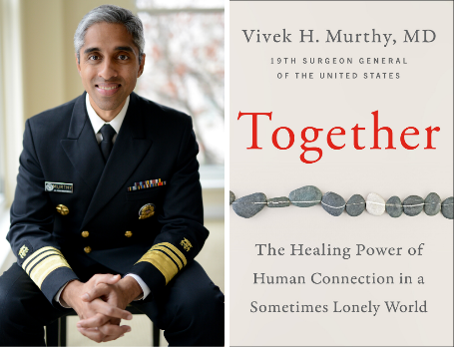
Importance of community Dr. Vivek Murthy
Dr. Murthy said communities provide “social inclusion” important to human health; loneliness has been associated with heart disease, high blood pressure, stroke, dementia, depression, anxiety
In 2017 Dr. Murthy said a lack of social connections in the workplace was contributing to a loneliness epidemic; face-to-face social interactions are key to feeling happier and more content

Slide 20
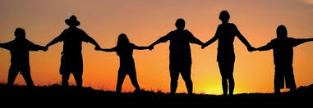
Building a community at work
Being in community is about connecting as human beings
We can treat each other with respect
We can greet each other in the hallway
We can chat over meals
We can help people get to know each other
We can encourage each other in our daily work

Slide 21
Building a community at work
We can build our community at work by sharing information with people
We can emphasize teamwork and cooperation
We can celebrate milestones in the work of the organization, and thank everyone for their roles in reaching the milestones

Slide 22
Building a community at work
We can celebrate special events in the personal lives of our colleagues– birthdays, weddings, births, promotions, retirements
We can help people during difficult times– a colleague who is ill, or who has lost a loved one, or who is caring for a loved one, or who is facing any of life’s special challenges or tragedies

Slide 23
Building a community at work
We can build our community at work by creating an environment that calms people’s fears
People typically live with lots of fears about both their personal lives and their work lives

Slide 24
Human beings have fears
Fear of losing one’s job
Fear of failure to provide for one’s family
Fear of losing the basics— food, clothing, shelter
Fear of personal illness or injury
Fear of losing loved ones through death
Fear of letting people down
Fear of losing relationships
Fear of losing membership in a group

Slide 25
Human beings have fears
Fear of losing status or respect
Fear of public embarrassment
Fear of hurting others
Fear of being hurt by others
Fear of public speaking
Fear of death
Fear of the future in general (what is happening in the world)

Slide 26
Calming the fears
People do not do their best work when they are fearful
Their fears affect how they interact with others at home and at work
It is hard to compartmentalize our lives so that our fears are left at home when we come to work
We can calm the fears of our colleagues by creating “Circles of Safety”

Slide 27
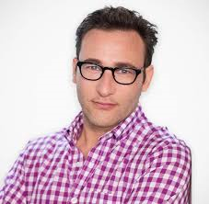
Simon Sinek Circle of Safety
In his book, Leaders Eat Last: Why Some Teams Pull Together and Others Don’t, Simon Sinek says: “By creating a Circle of Safety around the people in the organization, leadership reduces the threats people feel inside the group, which frees them up to focus more time and energy to protect the organization from the constant dangers outside and seize the big opportunities.”

Slide 28
Simon Sinek Circle of Safety
In a Circle of Safety, “we feel valued by our colleagues and we feel cared for by our superiors. We become absolutely confident that the leaders of the organization and all those with whom we work are there for us and will do what they can to help us succeed... When the Circle is strong and that feeling of belonging is ubiquitous, collaboration, trust and innovation result.”

Slide 29
Comments or questions…

Slide 30
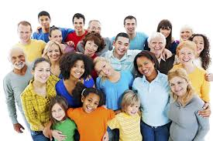
Reflection
What does “community” mean to you?
What have you done, or what can you do in the future, to create a community?

Slide 31
The rise of
large institutions

Slide 32
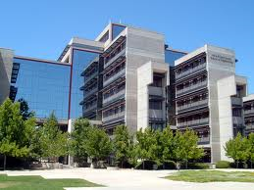
Reflection
How well are you served, personally, by the institutions you interact with on a regular basis? Think about businesses, government agencies, schools, hospitals, non-profit organizations…
How might these institutions serve you better?

Slide 33
Rise of large institutions
Governments and churches have been large institutions for thousands of years
For-profit private corporations are relatively new
In 1800, it is estimated that there were only 335 profit-seeking corporations in the United States, and they were mostly turnpike, bridge, canal, water, and fire protection companies (public utilities)

Slide 34
Rise of large institutions
Larger private corporations like the railroads, banks, and steel companies emerged after the Civil War (1861-1865)
New laws gave corporations liability protection, the ability to choose their purpose, and the privilege of continuing in perpetuity

Slide 35
Rise of large institutions
The modern corporation is a legal person, separate from the people who create it, lead it, or work for it
If a for-profit corporation fails, shareholders may lose their investment and employees may lose their jobs, but neither the shareholders nor the employees will be liable for the debts of the corporation unless they personally guaranteed them

Slide 36
Big companies, big profits
In 2018, the Fortune 500 companies represented two-thirds of the U.S. Gross Domestic Product with $12.8 trillion in revenues, $1.0 trillion in profits, and $21.6 trillion in market value
They employed 28.2 million people worldwide
The top ten companies were Walmart, Exxon Mobil, Berkshire Hathaway, Apple, UnitedHealth Group, McKesson, CVS Health, Amazon.com, AT&T, and General Motors

Slide 37
Big institutions, big impacts
In the United States, most new jobs are created by small businesses, which still play a major role in the economy
However, big companies have become more and more influential
Some non-profits have also become very large
Our society and our economy have been changed by these large institutions

Slide 38
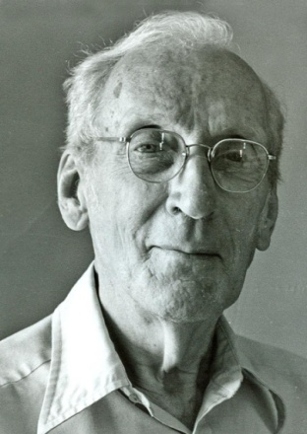
Greenleaf on institutions
Robert Greenleaf, who launched the modern servant leadership movement, was very concerned about the impact that big institutions were having on our society
He believed that it is essential that they become “servant institutions”
In his essay, The Institution as Servant, he articulated his “credo”

Slide 39
Greenleaf Credo The Institution as Servant
“This is my thesis: caring for persons, the more able and the less able serving each other, is the rock upon which a good society is built. Whereas, until recently, caring was largely person to person, now most of it is mediated through institutions — often large, complex, powerful, impersonal; not always competent; sometimes corrupt.”

Slide 40
Greenleaf Credo The Institution as Servant
“If a better society is to be built, one that is more just and more loving, one that provides greater creative opportunity for its people, then the most open course is to raise both the capacity to serve and the very performance as servant of existing major institutions by new regenerative forces operating within them.”

Slide 41
An opportunity to serve
As individuals and communities we depend on our institutions to serve us well
Servant-leaders can improve the performance as servant of the institutions they serve
Leading a servant institution is an opportunity to make a difference and leave an important legacy

Slide 42
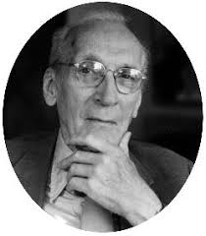
Leadership crisis
In his essay, The Leadership Crisis, which he published in 1978, Greenleaf expressed his disappointment in how little was being done at universities to prepare students to serve and lead. He argued that there was no precedent for the leadership crisis, because the dominance of major institutions was a new phenomenon.

Slide 43
Institutional revolution
Greenleaf was concerned that colleges and universities were not preparing young people to lead these new institutions. Toward the end of his life, Greenleaf affirmed that “we have not yet come to grips with the institutional revolution that came hard on the heels of the industrial revolution, and that we confront a worldwide crisis of institutional leadership.”

Slide 44
The loss of trust
in institutions

Slide 45
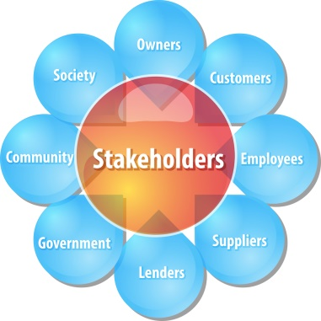
Institutional revolution
Greenleaf was right: we have not yet come to grips with the institutional revolution
Major institutions are struggling with their missions, their relationships with stakeholders, and their responsibilities to society
They need to decide: What is the appropriate definition of institutional success? Is it generating a profit or surplus, or is it adding value, or both?

Slide 46
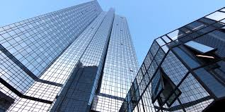
Questions
What do you think should be the appropriate definition of institutional success?
Should it be generating a profit or surplus, or serving employees, or serving customers, or serving society, or… all of those things and more?

Slide 47
According to the Edelman, a communications marketing firm, “trust is a forward-facing metric of stakeholder expectation. It is an asset that institutions must understand and properly build in order to be successful in today’s complex world.”
Edelman reported that “countries with higher trust levels overall also show a greater willingness to trust new business innovations.”

Slide 48
“Building trust is essential to successfully bringing new products and services to market… building trust in new business innovations requires that companies demonstrate clear personal and societal benefits, behave with integrity and engage with customers and stakeholders throughout the process.”

Slide 49
In a survey of 27 countries, the 2015 Edelman Trust Barometer found that the number of trusting countries fell to the lowest level ever recorded by the Edelman Trust Barometer.
Informed publics in only six of 27 countries surveyed expressed trust levels above 60 percent.

Slide 50
Trust in business in the United States was only 60 percent. In a majority of countries, the trust in business was below 50 percent.
Governments remained the least-trusted institutions globally, with trust levels at 48 percent.
Non-governmental organizations were the most trusted, but levels of trust rose only as high as 63 percent.

Slide 51
Question
What can leaders do to increase the trust in their organization?

