Slide 1
5- The Modern Servant
Leadership Movement
Servant Leadership Core Slides
Dr. Kent M. Keith
2020

Slide 2
The Modern Servant
Leadership Movement

Slide 3
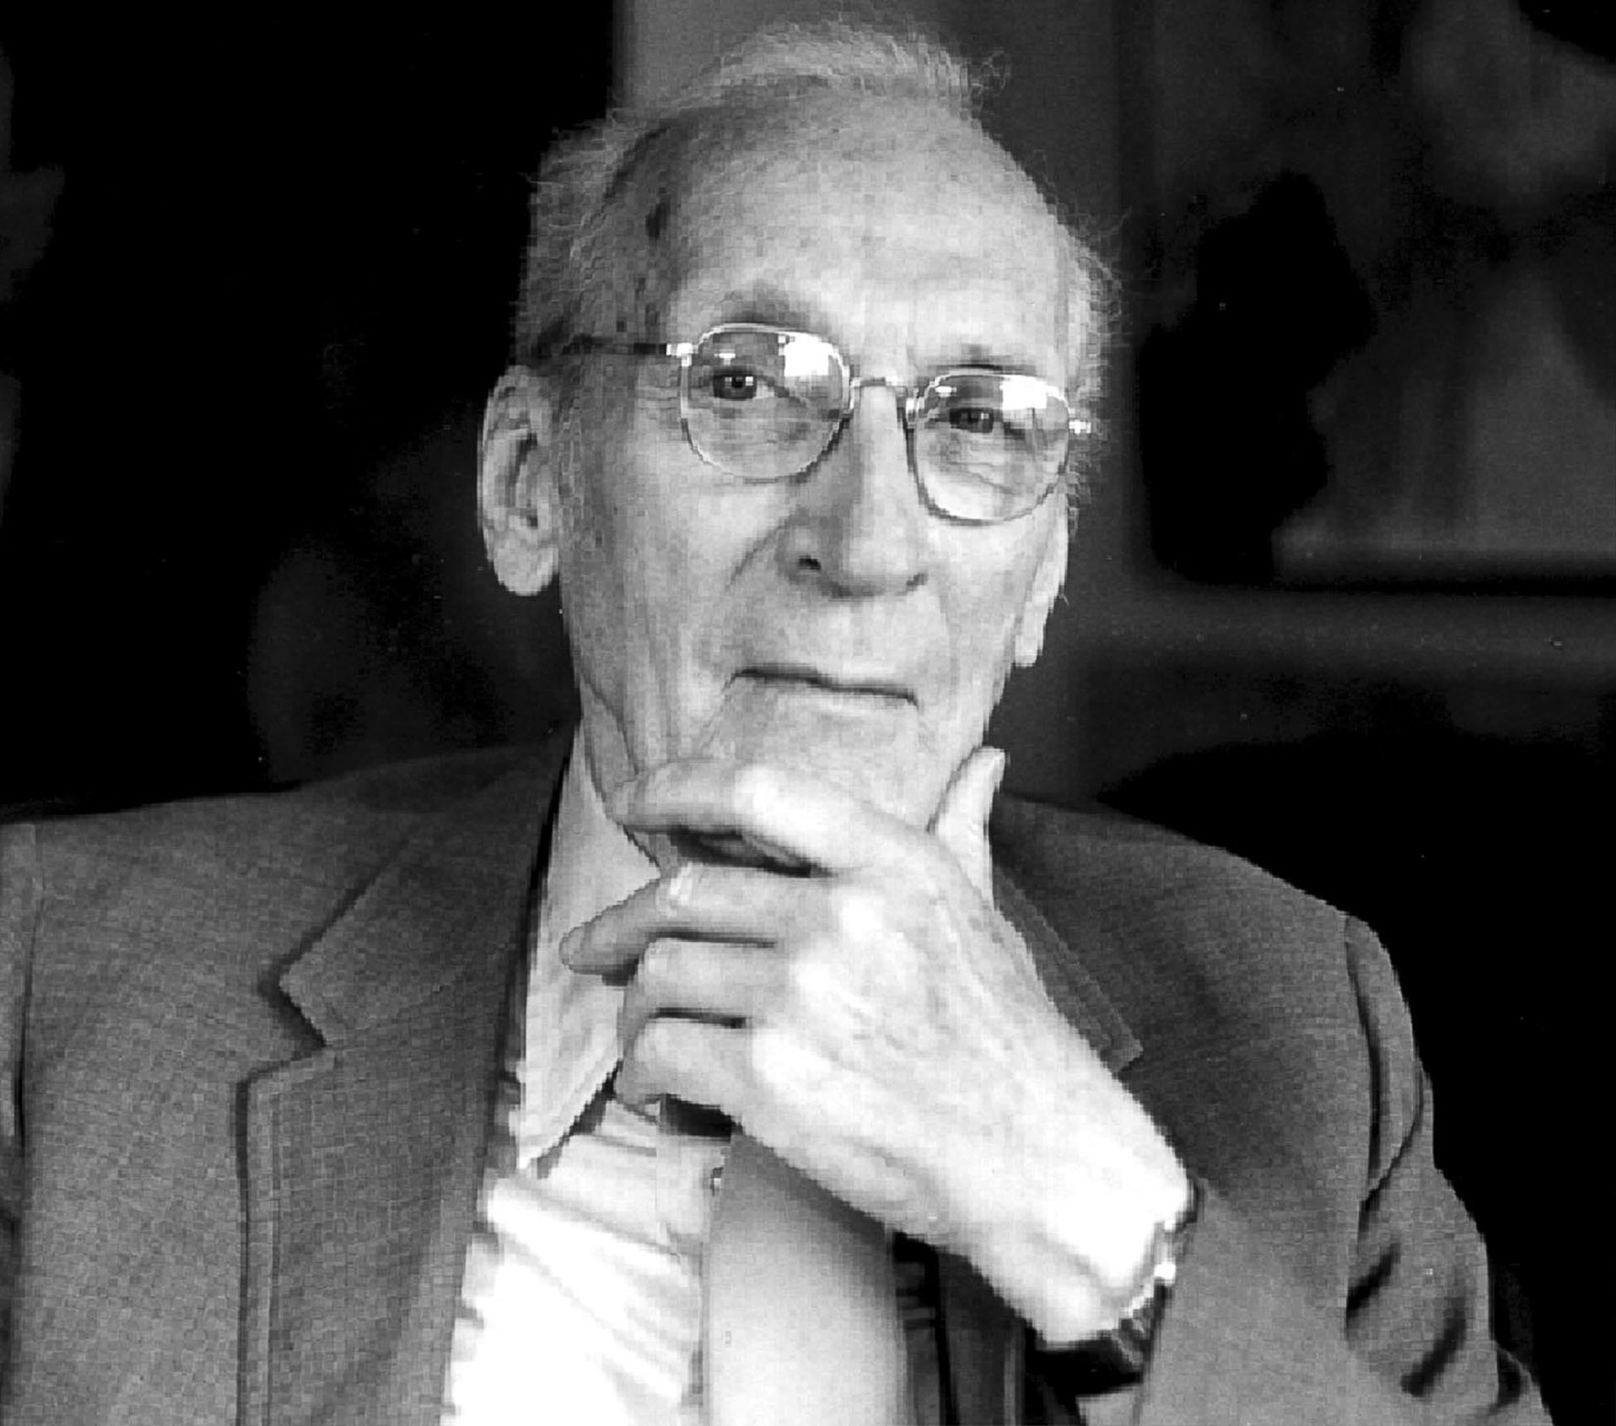
Modern Movement
The idea of servant leadership goes back thousands of years, and can be found in a number of traditions
However, there is a modern servant leadership movement
It was launched in the United States in 1970 by Robert K. Greenleaf, who coined the words “servant-leader” and “servant leadership”

Slide 4
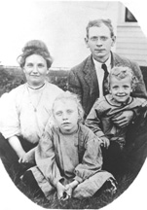
Robert K. Greenleaf
(1904-1990)
Greenleaf was born and raised in Indiana
While he was growing up, a huge change was taking place in the world, brought about by the rise of corporations in the late nineteenth and early twentieth centuries
Corporations were growing in their importance and impact on society

Slide 5

Change from within the organization
While a student at Carleton College in the 1920s, Greenleaf was influenced by a professor who pointed out that big institutions were not serving well, and can only be changed and made to serve by leaders within the organization who know how to do it and want to do it
Greenleaf took his professor’s advice and decided to focus on changing an institution from the inside

Slide 6
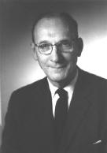
Change from within the organization
Greenleaf served AT& T from1926-1964
During that time, AT&T was the largest or one of the largest corporations in the world (more than a million employees)
Greenleaf started by digging holes for telephone poles, then became involved in teaching, training, and personnel assessment

Slide 7
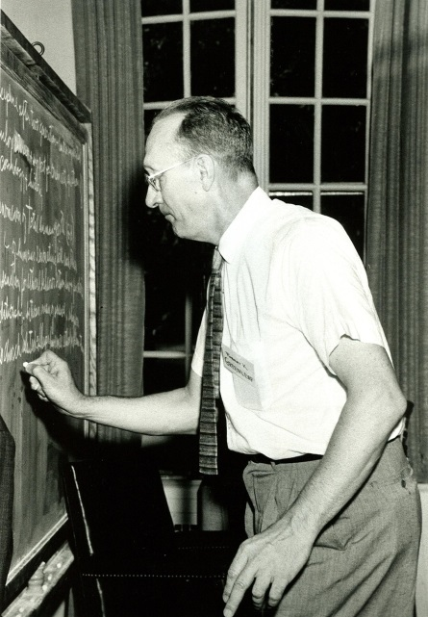
Robert K. Greenleaf
Eventually, Greenleaf became AT&T’s Director of Management Research
It was his job to teach and train leaders and managers of one of the world’s largest corporations to be as effective as possible

Slide 8
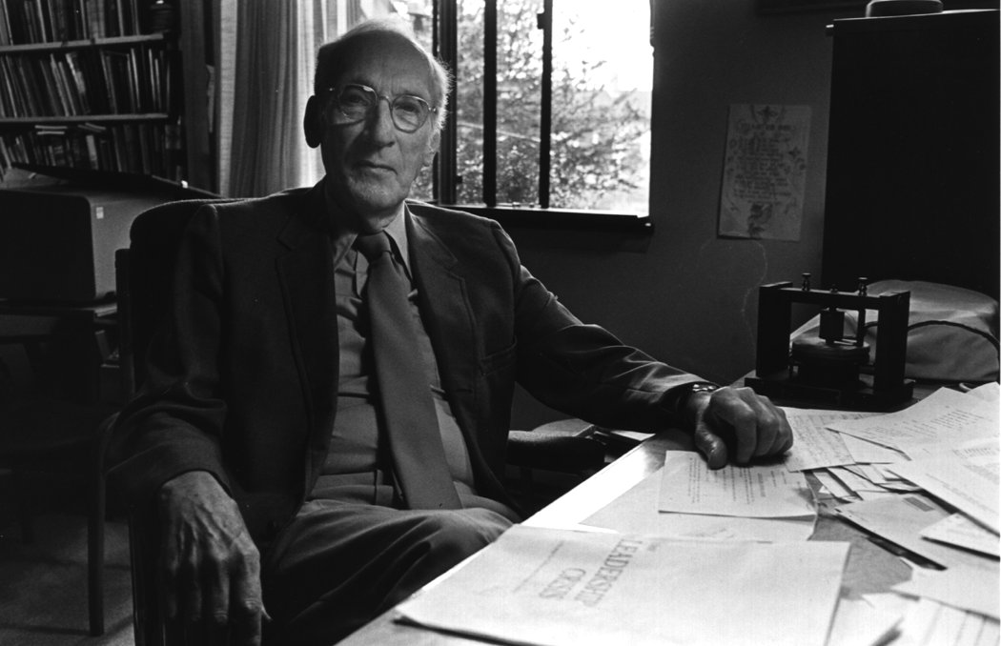
Teaching and consulting
He taught at Dartmouth, Harvard Business School, MIT, University of Virginia, Salzburg Seminar
He helped Thomas Watson, Jr, reorganize IBM
He was a consultant to the Ford Foundation (including work in India), Lilly Endowment, Mead Corporation, Sister of Mercy Health Corporation, American Institute of Certified Public Accountants
His consulting advice led to the establishment of the Center for Creative Leadership

Slide 9
The most effective leaders
Reflecting on his experience while training and educating the leaders of AT&T, Greenleaf concluded that the most effective leaders were those who focused on serving their colleagues and customers
For Greenleaf, this was not a theory, it was a conclusion based on practical experience

Slide 10
Greenleaf’s major works on servant leadership
The Servant as Leader (essay, 1970/73)
The Institution as Servant (essay,1972)
Trustees as Servants (essay,1974)
Teacher as Servant (parable, 1979)
Servant: Retrospect and Prospect (essay, 1980)

Slide 11
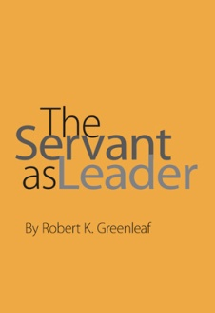
The Servant as Leader
Greenleaf launched the modern servant leadership movement with the publication of his classic essay, The Servant as Leader, in 1970
Greenleaf revised and republished the essay in 1973
The essay has been read by hundreds of thousands of people since then

Slide 12
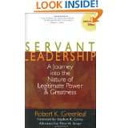
Servant Leadership (1977)
Greenleaf’s 1977 collection of essays (Servant Leadership: A Journey into the Nature of Legitimate Power and Greatness) ranks high on the Amazon.com list of most-purchased books
The book has rated as high as #8 on a list of all management and leadership books purchased
People are still reading Greenleaf’s work

Slide 13
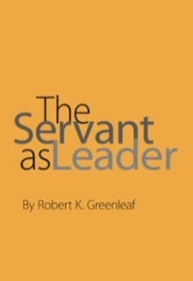
The Servant as Leader
Greenleaf’s essay told the story of Leo, coined the words “servant-leader,” defined the servant-leader, and described his/her characteristics
He told the stories of John Woolman (an American Quaker), Thomas Jefferson (American President), and Nikolai Grundtvig (Danish folk schools)
He mentioned the importance of institutions and trustees but focused primarily on the individual servant-leader

Slide 14

The Story of Leo
After retiring from AT&T in 1964, Greenleaf worked with college students
He read a book they were reading, Journey to the East, by Herman Hesse
The book tells the story of Leo, who does chores for a group of travelers, and also sustains them with his spirit and song

Slide 15
The Story of Leo
When Leo disappears one day, the group falls into disarray and the journey is abandoned
Later, one of the travelers seeks out Leo and finds that he is the great and noble leader of the Order that sponsored the journey
This triggered Greenleaf’s idea of the servant as leader

Slide 16
Defining the servant-leader
Greenleaf said: “The servant-leader is servant first…It begins with the natural feeling that one wants to serve, to serve first. Then conscious choice brings one to aspire to lead.”

Slide 17
Leo: Servant first
“Leo was actually the leader all of the time, but he was servant first because that was what he was, deep down inside. Leadership was bestowed upon a man who was by nature a servant. It was something given, or assumed, that could be taken away. His servant nature was the real man, not bestowed, not assumed, and not to be taken away. He was servant first.”

Slide 18
Servant-first vs leader first
“[The servant-first] is sharply different from one who is leader first, perhaps because of the need to assuage an unusual power drive or to acquire material possessions…”

Slide 19
The difference
“The difference [between the servant-first and leader-first] manifests itself in the care taken by the servant-first to make sure that other people’s highest priority needs are being served.”

Slide 20
The Best Test
Greenleaf’s test for servant-leaders was: “Do those served grow as persons? Do they, while being served, become healthier, wiser, freer, more autonomous, more likely themselves to become servants?”

Slide 21
Caring for the least privileged
Greenleaf said that when servant-leaders make decisions, they should ask: “What is the effect on the least privileged in society? Will they benefit or at least not be further deprived?”

Slide 22
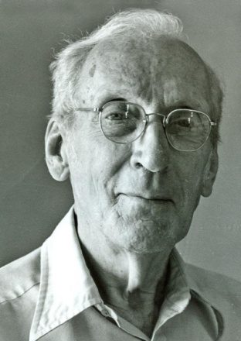
Growing people
Greenleaf said that no matter what specific industry or line of business an organization is in, the most fundamental business of every organization is growing people

Slide 23
Unlimited liability
Greenleaf said that serving each other requires love. He noted that love is undefinable. “But it begins, I believe, with one absolute condition: unlimited liability! As soon as one’s liability for another is qualified to any degree, love is diminished by that much.”

Slide 24
Lost knowledge of community
Greenleaf said that the opportunities are tremendous for rediscovering vital lost knowledge about how to live in community…
“All that is needed to rebuild community… is for enough servant-leaders to show the way, not by mass movements, but by each servant-leader demonstrating his own unlimited liability for a quite specific community-related group”

Slide 25
Identifying and meeting needs
Servant-leaders identify and meet the needs of others
They identify and meet the needs of colleagues so they can perform at their highest levels
They identify and meet the needs of customers so they will be truly served and the organization will succeed

Slide 26

Getting it done
Servant-leaders watch, listen, determine what needs to be done, and then take responsibility to make sure it gets done
If the servant-leader is not the right person to do what needs to be done, the servant-leader finds someone who is the right person

Slide 27
Choosing to be responsible
Greenleaf said: “Responsibility is a necessary condition for the wholeness and fullness of life, and a person who cannot assume it may be denied the greatest opportunity which life offers to anyone: to be a whole person, to be right with the world, to belong.”

Slide 28


Personal Reflection
For whom or what are you willing to be responsible?

Slide 29
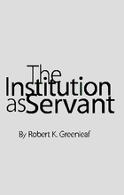
The Institution as Servant by Robert Greenleaf
The essay begins with the “credo” regarding how a better society can be built by raising the capacity of existing major institutions to serve
Greenleaf challenged conventional wisdom about hierarchical organizational structures, and argued instead for a “first among equals” model with teams
He discussed conceptual and operating talent
He also emphasized the role of trustees (boards)

Slide 30

Greenleaf Credo
The Institution as Servant
“This is my thesis: caring for persons, the more able and the less able serving each other, is the rock upon which a good society is built. Whereas, until recently, caring was largely person to person, now most of it is mediated through institutions — often large, complex, powerful, impersonal; not always competent; sometimes corrupt.”

Slide 31
Greenleaf Credo
The Institution as Servant
“If a better society is to be built, one that is more just and more loving, one that provides greater creative opportunity for its people, then the most open course is to raise both the capacity to serve and the very performance as servant of existing major institutions by new regenerative forces operating within them.”

Slide 32

Greenleaf’s ultimate goal for servant leadership
Servant-leaders help their organizations to become servant-institutions
Servant-institutions focus on serving their employees, customers, and communities
The quality of our lives will improve, and our society will be more just and loving, more creative and productive,with greater opportunities for its people

Slide 33

Comments or questions…

