Slide 1
16- Institutional Principles: Purpose, Employees, Customers
Servant Leadership Core Slides
Dr. Kent M. Keith
2022

Slide 2
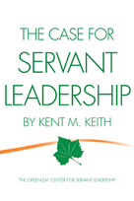
Key Practices and Institutional Principles
In 2008, Dr. Keith articulated seven key practices of servant leaders
The key practices focus on team leadership at the unit or division level
Later, Dr. Keith articulated eight institutional principles of servant leadership
The institutional principles focus on leadership of the entire organization

Slide 3
Institutional Principles
Reach agreement on the organization’s purpose and desired outcomes
Serve employees
Serve customers
Build and facilitate teams
Develop an effective board
Strengthen partnerships
Serve communities
Grow servant leaders

Slide 4
Institutional Principles
Reach agreement on the organization’s purpose
and desired outcomes

Slide 5
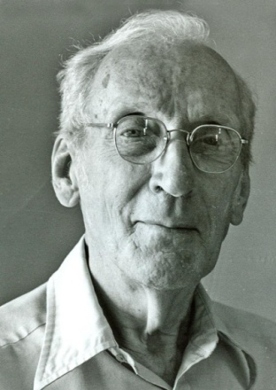
The unifying dream
“Institutions function better when the idea, the dream, is to the fore, and the person, the leader, is seen as the servant of the idea… It is the idea that unites people in the common effort… It is the communicated faith of the leader in the dream that enlists dedicated support needed to move people toward accomplishment of the dream.”
--Robert K. Greenleaf

Slide 6
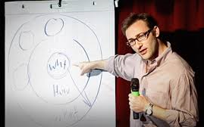
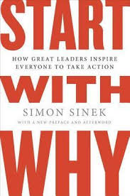
Simon Sinek Start with Why
Simon O. Sinek is a British-American author, motivational speaker, marketing consultant, and author
His talk How Great Leaders Inspire Action is listed as the third most popular TED talk of all time (36 million views)
His books include Start with Why, and Leaders Eat Last

Slide 7
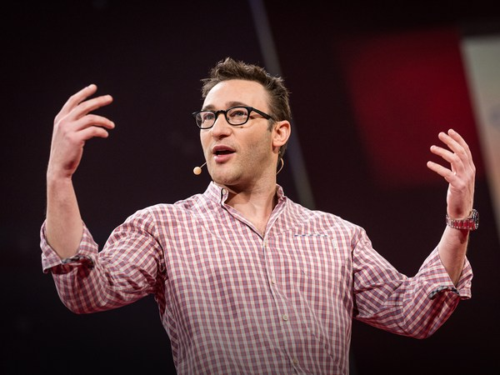
Simon Sinek
https://www.youtube.com/watch?v=u4ZoJKF_VuA

Slide 8
Steps
Articulate the dream or purpose
Establish the mission, create the vision, identify the values
Determine the desired outcomes, such as:
Employee engagement and retention
Customer/member satisfaction
Reaching new customers/members
Impact on communities, society at large
Building strength for the future

Slide 9
Purpose
The founder of the Tata Group believed that acquiring wealth was not the primary purpose— the company’s mission was to help the communities in which it operated
“Purpose is not about corporate strategy or tactics… Purpose is a spiritual and moral call to action; it is what a person or company stands for.”
--R. Tata, S. Hart, A. Sharma, C. Sarkar
MIT Sloan Management Review (2013)

Slide 10
“High-commitment high-performance CEOs understand that being part of an enterprise that is helping to create a better world unleashes the commitment and energy of their people.”
--“The Uncompromising Leader,” July-August 2008
by Eisenstat, Beer, Foote, Fredberg, Norrgren

Slide 11
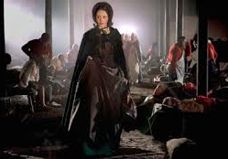
Florence Nightingale
Florence Nightingale believed that she was called to heal
Against the opposition of her family, she became a nurse
She took a group of 38 nurses and 15 nuns to Scutari in 1854 to serve thousands of British soldiers wounded in the Crimean War
She established a nursing school and the modern profession of nursing

Slide 12
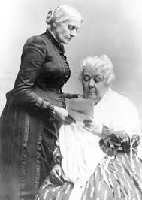
Stanton and Anthony
Elizabeth Cady Stanton and Susan B. Anthony gave their lives to the women’s movement, speaking, writing, and lobbying legislators for women’s right to vote
The movement that they led achieved the goal in 1920— 72 years after Stanton started the movement

Slide 13
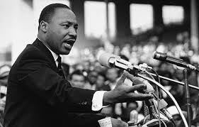
Martin Luther King, Jr
King’s “I Have a Dream” speech was delivered on August 28, 1963, to over 250,000 civil rights supporters from the steps of the Lincoln Memorial during the March on Washington
His speech is considered to be one of the greatest speeches in American history

Slide 14
Comments or questions…

Slide 15
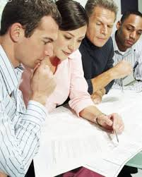
Reflection
How would you describe the unifying dream or purpose of your organization?
Is it embodied in your mission, vision, values, and/or goals?

Slide 16
Institutional Principles
Serve employees

Slide 17
Steps
Commit to the employee’s success
Provide supportive working conditions, equipment
Tailor employee benefits to meet needs
Provide training and continuing education
Set up regular systems for employee input
Help employees grow
Offer promotion opportunities from within

Slide 18
Putting employees first
Southwest Airlines carries the most domestic passengers of any US airline, and is highly profitable
Southwest puts employees first, hires for "attitude before aptitude" and allows employees to be themselves at work
The founders' philosophies included servant leadership and a "fun-LUVing" attitude

Slide 19
Individual Development Plans
Establish an individual development plan for each employee
Ask employees: How do you want to grow? What do you want to learn? How can we help you?

Slide 20
Individual Development Plans
The plan can include new experiences, seminars, travel, field trips, team-building exercises, skills training, formal education, and/or new positions within the organization

Slide 21
Comments or questions…

Slide 22
Reflection
How does your organization serve its employees?
How might your organization serve its employees better?

Slide 23
Institutional Principles
Serve customers

Slide 24
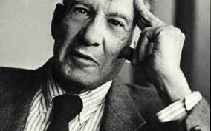
Peter Drucker The Effective Executive
Drucker said that the question that distinguishes a person as an executive is: What can I contribute?
The executive focuses on the entire organization and its purpose, and thinks in terms of the customer, client, or patient, who is the ultimate reason for whatever the organization produces

Slide 25
Steps
Create a variety of ways to listen to customers/ members to identify their wants and needs
Listen to customers/members during program or product creation, purchase, and use
Report back to customers regarding their input and action taken by the organization
Respond to customer/member complaints by working with the customer to reach solutions

Slide 26
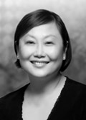
Identifying Needs
Dr. Mary Ann Tsao began by listening— by visiting many people and asking, what are the needs of the community? What are the needs of the elderly in Singapore?
The answers shaped the Tsao Foundation program, which has been serving the elderly in Singapore for decades

Slide 27
Responding to complaints
Starbucks is one of the most successful companies in the world
Starbucks has made it a habit to sit down and listen to customers or neighbors who have complaints about their products or stores
Customers are asked for their suggestions to make things better— suggestions that are often positive and can be implemented

Slide 28
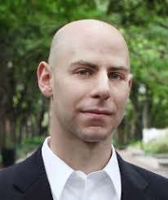
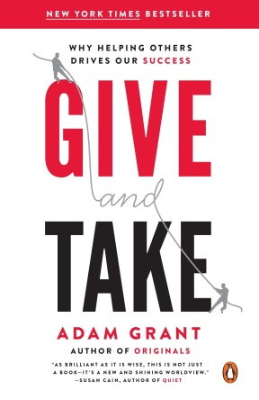
Adam Grant Give and Take
In his book, Give and Take: Why Helping Others Drives Our Success, Grant reports on research regarding effective salespeople
The most successful salespeople are those who spend time getting to know the customer and his or her needs, developing trust

Slide 29
Adam Grant Give and Take
Grant conducted a survey of opticians to determine which ones were “givers,” “takers,” and “matchers,” and then compared the results with sales revenue
The average “giver” brought in over 30 percent more annual revenue than “matchers” and 68 percent more than “takers”
The “givers” gave their time and attention to others, building relationships

Slide 30
Adam Grant Give and Take
“By asking questions and getting to know their customers, givers build trust and gain knowledge about their customers’ needs. Over time, this makes them better at selling.”
“In one study, pharmaceutical salespeople were assigned to a new product with no existing client base. Each quarter…the givers pulled further ahead of the others.”

Slide 31
Comments or questions…

Slide 32
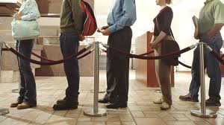
Reflection
How does your organization serve its customers/members/students?
How might your organization serve them better?

